Slide 1

Introductions

Slide 2
Understanding a Normal Electrocardiogram Complex (EKG or ECG ) Using a Medieval Analogy

Slide 3
Why is This Lesson Important?
Attain the ability to identify the individual waveforms of an EKG complex.
Provides a basic foundation regarding the normal electrical conduction within the heart.
Recognize what a “Normal” EKG complex looks like.
This will establish a foundation on which, one will be able to use when analyzing EKG rhythms and EKG strips.

Slide 4
Objectives
Upon completion of presentation, the student will be able to:
Identify each component of an EKG complex.
Match individual waveforms of an EKG complex with the specific electrical conduction within the heart.
Verbalize the correct electrical sequence of a single EKG complex.
Use this presentation as a building block for future classes.

Slide 5
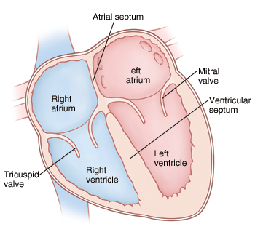
Basic Components of the Heart - The Kingdoms
The Kingdoms:
Right and Left atrium are the upper kingdoms where the royals live
The heart valves divide the upper and lower lands
Right and Left ventricles are where the peasants live
The Ventricle Septum is a large mountain range separating the lower villages

Slide 6
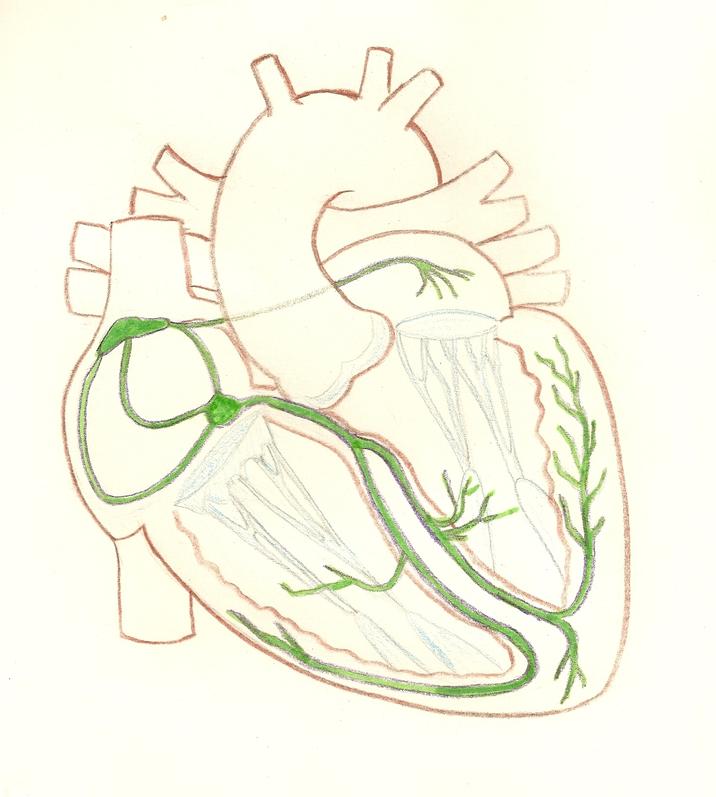
Electrical Pathway - Route that the King’s Message Travels
Bachmann’s Bundle
SA Node
Left Bundle Branch
AV Node
Purkinje Fibers
Right Bundle Branch

Slide 7
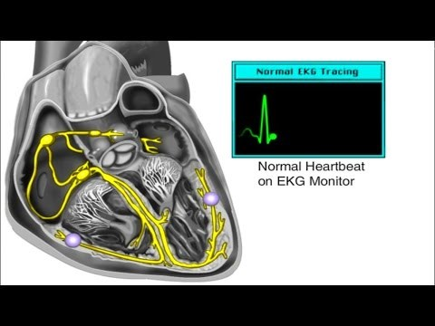

Slide 8
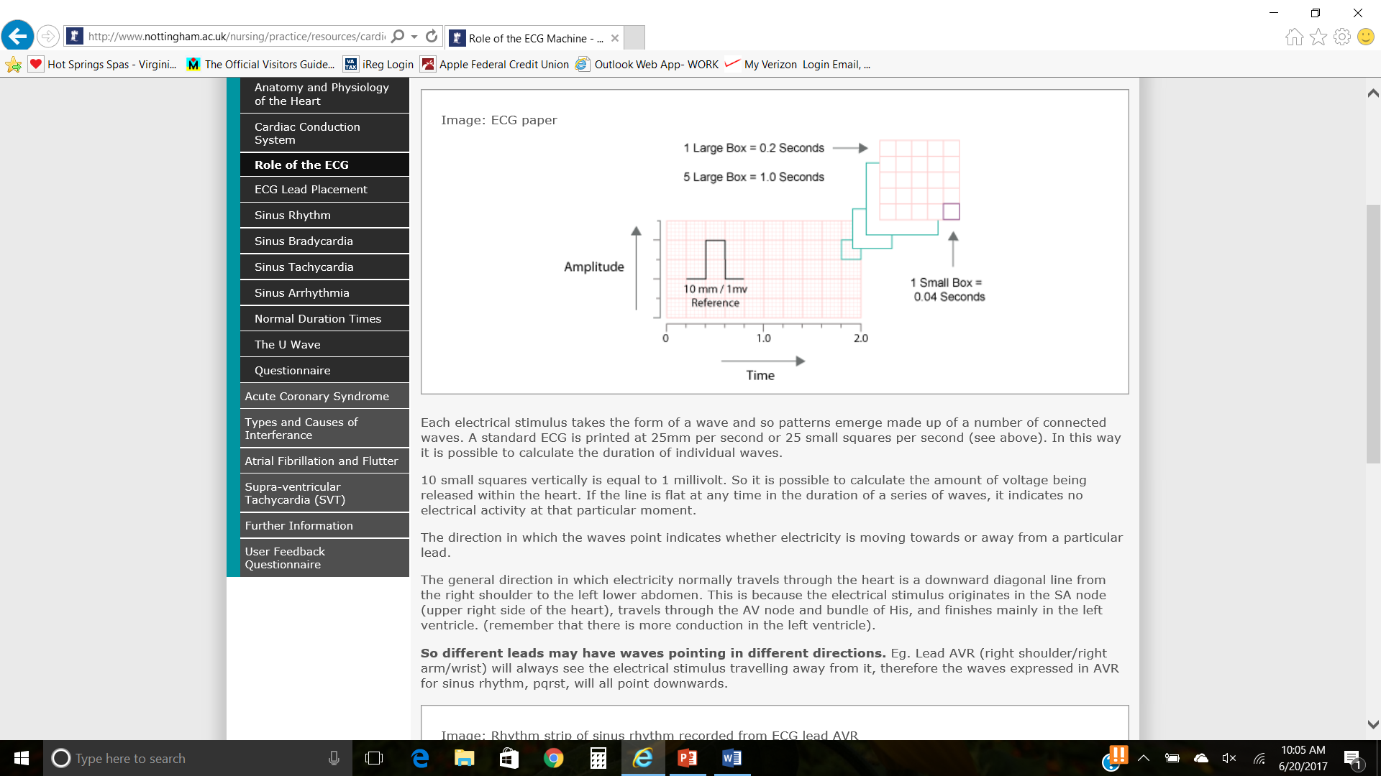
Graph used when Interrupting an EKG Complex
5 Large Boxes = 1.0 Seconds
Notes:
Amplitude is also voltage

Slide 9
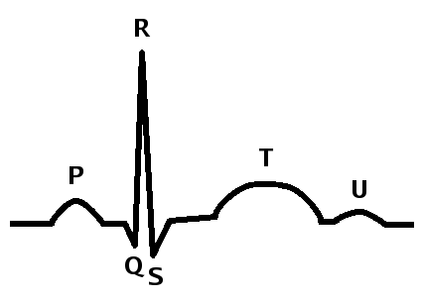
Components of a Normal EKG Complex
as seen in Lead II
Notes:
Lead II is used to look at EKG complexes because follows the normal conduction direction of the heart best. A downward, diagonal line - Right shoulder across and down, to LUQ of ABD.

Slide 10
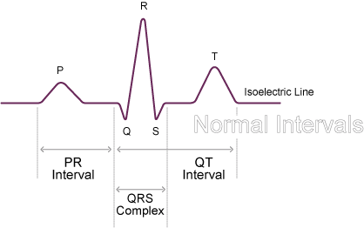
Normal Intervals of an EKG Complex
Notes:
Isoelectric line -

Slide 11
Sinoatrial or Sinus Node (SA Node) – The King
Generates the message and hands it off to the Messenger
Pacemaker of the heart – sets the heart rate
This is the P wave seen within an EKG complex
First positive deflection of EKG complex in Lead II

Slide 12
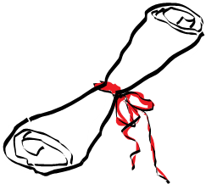

PR Interval
Represents the Messenger traveling from the King (SA Node) to the Gate Keeper (AV Node)
Starts from the beginning of P wave to beginning of QRS complex
PR Interval is the depolarization (contraction) of the atrium
Normal interval is 0.12 to 0.20 sec
If Messenger gets to the Gate Keeper before 0.12 sec
Someone else is pretending to be the messenger
If Messenger takes longer than 0.20 sec
Messenger is doing other things while in the route to the Gate Keeper
Notes:
If Messenger gets to the Gate Keeper before 0.12 sec
Someone else is pretending to be the messenger
If Messenger takes longer than 0.20 sec
Messenger is doing other things while in the route to the Gate Keeper

Slide 13
PR Interval

Slide 14
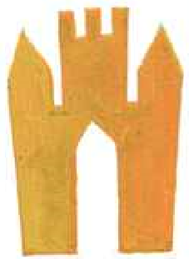
Atrioventricular Node (AV Node) – Gate Keeper
Controls the Messenger and number of messages to be sent to the Runners
At the AV node, the impulse is slightly delayed to allow for the ventricles to fill up with blood from the atrium.
Start of the QRS complex

Slide 15
Bundle of His, Bundles, and Purkinje Fibers – Runners
Carry Message to Outlying Villages, one heads to the left side and one to
the right side of the lower kingdom
Runner to the left is one step ahead of the runner heading to the right
QRS Complex - Includes 3 waveforms the Q, R, and S waves
Represents ventricular depolarization – ventricles contracting
Normal range is 0.08 to 0.10 sec
Notes:
The runners run down the bundles branches into the purkinje fibers reaching all the villages and small cottages throughout the lower kindom,. Right ventricle pumps blood to your lungs and the left ventricle pumps blood to the rest of your body.
If greater than 0.12 sec considered abnormal
Bundle of His

Slide 16
QRS complex
Q Wave
First downward or negative deflection of QRS complex
Represents depolarization of septum
May or may NOT be present
R Wave
First upward deflection after P wave
Represents the depolarization of the ventricles walls
The R wave is the largest wave generated (in normal conduction) due to the ventricle muscle wall thickness
S Wave
Represents the Purkinje Fibers depolarization (contracting)
May or may NOT be present

Slide 17
T wave
After QRS complex
Represents ventricular repolarization (relaxing)

Slide 18
QT Interval
Represents ventricle depolarization (contracting) to ventricle repolarization (relaxing)
Normal range 0.40 to 0.44 sec
Women often have longer QT intervals
May be longer due to medications
Lower heart rate can result in longer QT interval
Quick way to recognize prolonged QT is if T wave ends past the halfway point of an R to R interval, than is prolonged
Notes:
Prolonged QT People with this condition may not develop symptoms for a long time. When symptoms do occur, they can be severe, and may include sudden fainting, seizures, or even sudden death.

Slide 19
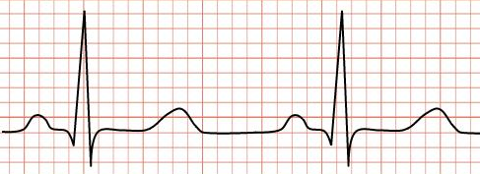
R to R Interval
R to R Interval

Slide 20
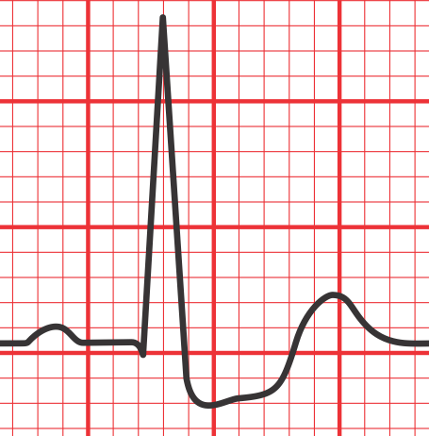
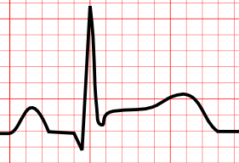
ST Segment
Normally is Isometric
If depressed or elevated could be a result of a Myocardial Infarction (MI)
ST Depression
ST Elevation

Slide 21
U Wave
Are NOT very common
May been prominent at slow heart rates
Represents the repolarization of the Purkinje Fibers
Can also occur with electrolyte imbalances specifically potassium

Slide 22
Electrical Pathway - Route that the King’s Message Travels
Bachmann’s Bundle
SA Node
Left Bundle Branch
AV Node
Purkinje Fibers
Right Bundle Branch

Slide 23
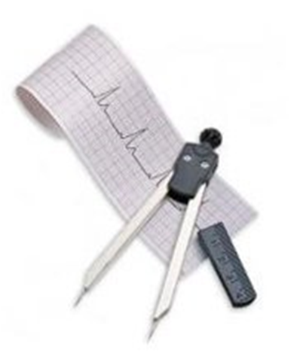
Measuring EKG Wave Forms and Intervals

Slide 24
Objectives Review
Identify each component of an EKG complex.
Match individual waveforms of an EKG complex with the specific electrical conduction within the heart.
Verbalize the correct electrical sequence of a single EKG complex
Use this presentation as a building block for future classes.

Slide 25

Questions

Slide 26
References
Heart chambers picture
https://www.google.com/url?sa=i&rct=j&q=&esrc=s&source=images&cd=&cad=rja&uact=8&ved=2ahUKEwiE0PXt7f3bAhVFx1kKHX6iAaQQjB16BAgBEAQ&url=https%3A%2F%2Fwww.sscadda.com%2F2016%2F07%2Fstudy-notes-on-human-heart.html&psig=AOvVaw2lkG1Ki4FEeghoJ_kIc_6D&ust=1530532934011823
Electric pathway picture
https://www.boundless.com/physiology/textbooks/boundless-anatomy-and-physiology-textbook/cardiovascular-system-the-heart-18/physiology-of-the-heart-175/electrocardiogram-and-correlation-of-ecg-waves-with-systole-877-10099/images/systole-qrs-complex/
Heart electrical conduction video
https://youtu.be/ftn4YqybQww?t=14
EKG strips
http://floatnurse-mike.blogspot.com/

